Slide 1
Bike Trail to Scale Activity
Kayla Quinter
Senior Civil Engineering Student
Cincinnati Country Day HS
Honors Geometry (9)

Slide 2
Unit Overview
Topic: Similar Polygons
Academic Content Standards:
CCSS.Math.Content.HSG-MG.A.3 Apply geometric methods to solve design problems.
CCSS.Math.Content.HSG-SRT.A.1b The dilation of a line segment is longer or shorter in the ratio given by the scale factor.

Slide 3
Bike Trail to Scale
Objectives & Guiding Questions
1. Identify the scale ratio of a scaled drawing
2. Identify the scale ratio of two similar shapes
3. Use ratios and proportions to determine the dimensions of similar shapes
4. Use a scale to create drawings, plans, blueprints
5. Become familiar with how scale factors, proportions, and ratios apply to real life designs
1. What is a scale as used in drawings and maps?
2. How do you determine the scale ratio between two similar shapes?
3. How do you use the scale ratios and proportions to find dimensions of similar shapes?
4. How can you use a given scale to create a blueprint or scaled drawing?
5. Where can you find scales being used?

Slide 4
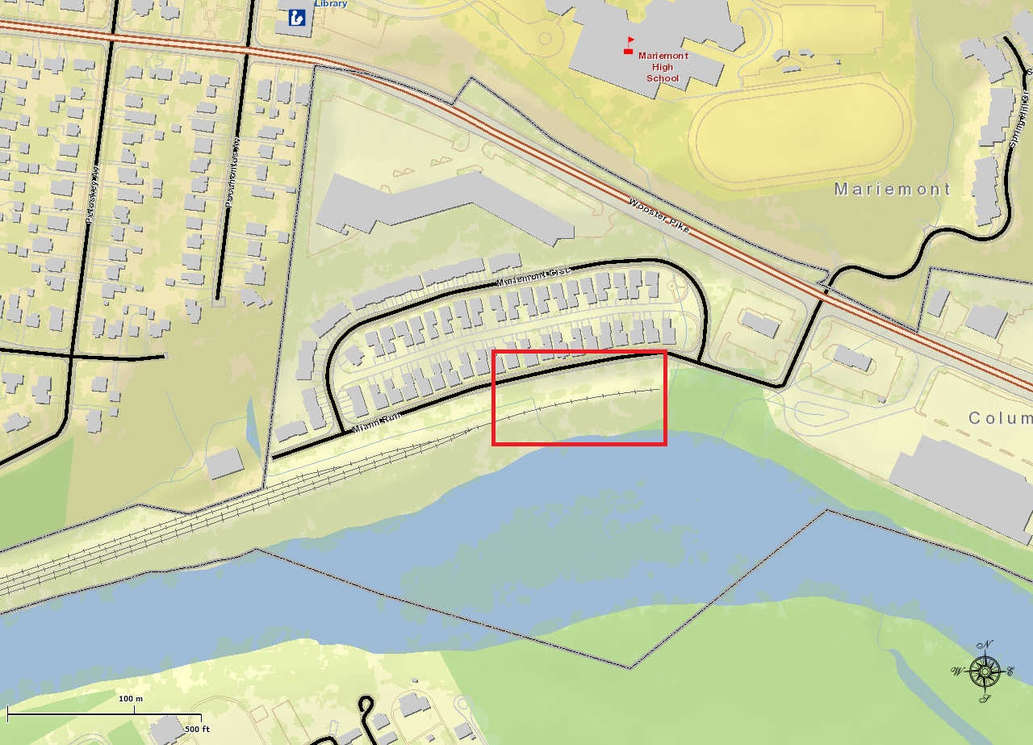
Activity
“(This activity) made me think about all the things engineers need to consider when they do a design” – Honors Geometry Student
Students were asked to design a bike trail considering:
Given “codes and standards”
Cost
Topography
Societal Impacts
Environmental Impacts
Given:
CAGIS map printout of the area
Tracing paper
“Codes and standards”
Topographic map of the area
CAGIS Map of Surrounding Area

Slide 5
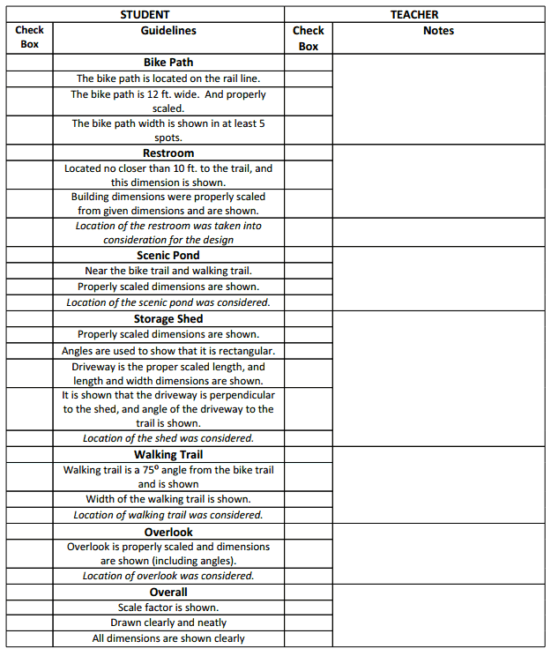
Activity Checklist
“Codes and Standards”

Slide 6
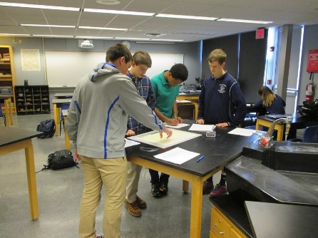
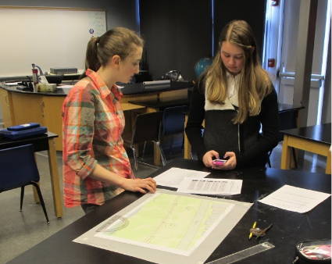
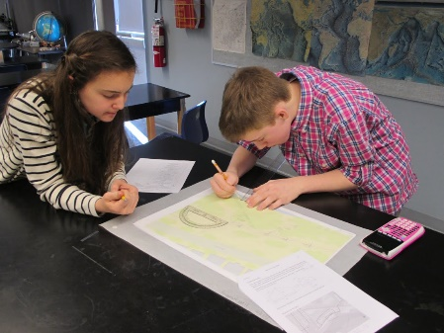
ACS
Real-World Application:
This bike trail is being designed as we speak by Wasson Way Groups and my senior class.
Career Awareness:
Shows students the multitude of things that need to be considered when an engineer does a design
Societal Impact:
Students had to consider this when doing their designs because of nearby housing units

Slide 7
Student Learning

Slide 8
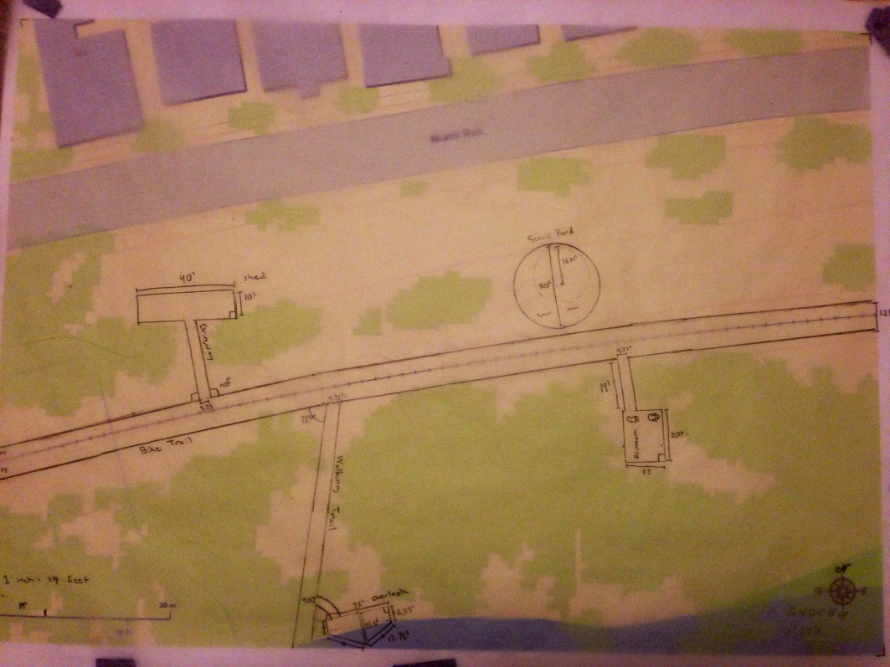
Student Work
“It was cool to see nothing and then see our design come to life” – Honors Geometry Student

Slide 9
Reflection
Students struggled and overcame the “non-pretty” scale
I was amazed with some of the design considerations groups presented:
One student thought about a bike path he had been on in New York before beginning the design
Hid the shed behind trees out of public eye
Truly showed engineer thinking abilities
Students were begging for a budget at the end

